Slide 1
Merging Tourism Information Centers and Sustainable Mobility Information Centers as Drivers for Tourism Development at Local Level
TARS – Tourism and Rural Space in National and International Context
May 27th, 2022
Authors: Melania Coman, INCDT
Rodica Trifanescu, INCDT
Irina Colceru, INCDT

Slide 2
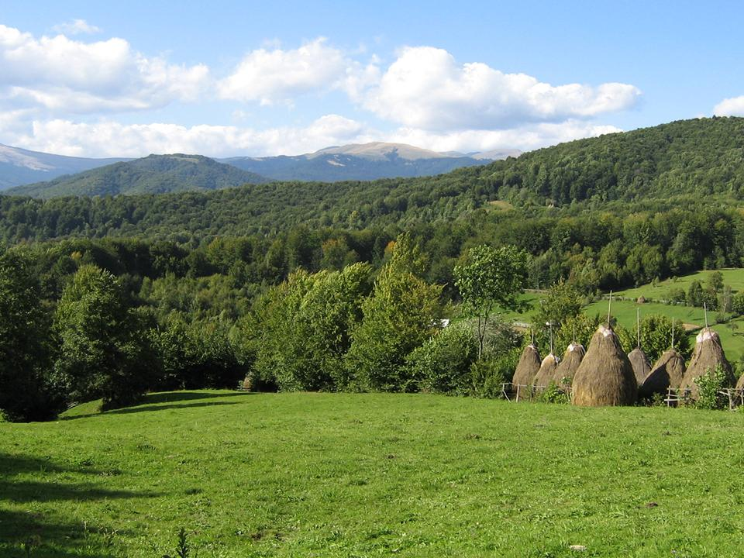

Slide 3
Methodological Approach
The present paper is developed under the Nucleu Contract no 15N/2019, using data from previous INCDT projects like Transdanube.Pearls
A comprehensive desk research of similar initiatives throughout Europe and worldwide
An evaluation of the previous Transdanube.Pearls results
The observation of how the two types of information centres work and how putting them together would benefit the local public authorities and local tourism

Slide 4
Tourism Information Centres
Legally established through the Ordinance 58/1998, further modified by Law 755/2001, as “specialized structure within the apparatus of the local public administrations and collaborates with the destination management organization, with the relevant Ministry in the field of tourism and the relevant Ministry in the field of spatial and urban planning”
TICs are given accreditation by the relevant tourism authorities at national level, according to the Order of the Minister of Economy, Energy and Business Environment no 2409/2020 (pre-requisites: office space, specialized staff, information materials, etc)
Their roles and responsibilities are:
  promotion of touristic potential at local, regional and national level
  presentation of the local, regional, national tourism offers and attractions, within the framework of local councils, county councils or the Bucharest Municipality General Council

Slide 5
Sustainable Mobility
Information Centres – Possible Approaches
Emerging tendencies in the tourism market push destinations to acknowledge mobility as a strategic component of tourism planning
Sustainable Mobility Information Centres (SMICs) can be defined as support structures for local, regional and national tourism activities
SMICs can be organized around the principles of tourism traffic analyses used in various European regions to assess and reduce the tourism mobility environmental impact.
SMICs can also be organized around the idea of sustainable mobility urban plans, as policy for sustainable development of both transport and tourism

Slide 6
Sustainable Mobility
Information Centres – Challenges
Traditionally, studies regarding transport and tourism kept these concepts separate, with transport being a means to an end
The integration of mobility – previously thought of as prerequisite for tourism, into the comprehensive planning of tourism development, as a middle perspective between mobility management and destination management
Convincing both tourists and tourism market actors of the benefits of integrating sustainable mobility and tourism activities

Slide 7
Sustainable Mobility
Information Centres – What They Do
SMICs support the local, regional and national authorities’ fight for reducing pollution and CO2 emissions related to the tourism activity
They provide access to information regarding ecological transportation, particularly for tourism
They educate tourists and visitors to have an environmentally friendly conduct and to be mindful of their health and safety, particularly during this post-COVID 2019 pandemic
SMICs can provide tourists and visitors with alternatives for transportation adapted to their vacation plans (touristic objectives they want to reach, touristic routes and eco-friendly transport options)

Slide 8
Sustainable Mobility
Information Centres – 3 Ways of Implementation
SMICs as part of the Public Transport Services – it is a possibility to be considered, especially since many cities worldwide provide their public transportation options through websites and brochures which can be found in strategically placed information centres city-wise
SMICs as part of public-private partnerships – though a desirable outcome, as it can be managed as a self-sustaining and self-financing organization, the legislative hassle can be too challenging, both for their establishment and their procedures and cash-flow.
SMICs as part of the Tourism Information Centres – an optimal solution, as it builds on an existing infrastructure, existing staff and already known venues.

Slide 9
Benefits of Merging SMICs within the Tourism Information Centres
Supporting Destination Management Organisations (DMOs) in sustainable tourism planning, particularly in areas with heavy traffic, by:
  Integrating regional transport means
  Increasing transport inter-modality
  Supporting local initiatives in the field of sustainable mobility
Simplifying and integrating public transport (ticketing, timetables, payment options, discounted offers, etc)
Unitary way of accessing and disseminating information for both tourism and transport (a “one-stop-shop” with free information at local and regional level regarding transport services for tourists, visitors and locals, as well as indicating what and where to visit)
Savings on management and implementation costs and overall effectiveness on providing both tourism and sustainable mobility information
Organizing local economy is easier to manage by integrating sustainable mobility and tourism

Slide 10
Conclusions
An integrated approach of tourism and mobility better tackles new trends in how vacations are planned and implemented, especially post-COVID.
Transport is an integral part of sustainable tourism, which is why sustainable mobility and eco-friendly transport means should be considered when approaching the development of safe and environmentally friendly touristic products and offers.
Local public authorities and relevant agencies can provide challenging routes, a diversity of transport and travel means, and a mix of experiences throughout the entire vacation planning and implementation process as a form of attracting tourists.
As such, we see the merging of the Tourism Information Centre with the Mobility Centre as an opportunity to create tourists’ curiosity and a lasting impression, thus benefitting the visitors, the travel and tourism businesses and local economy.

Slide 11
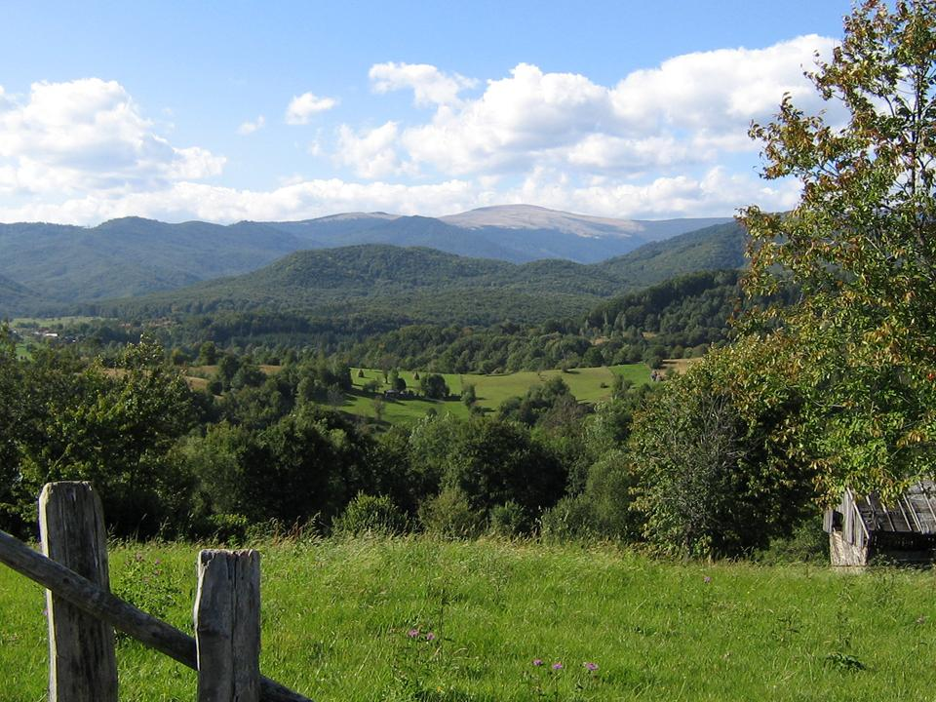
Thank you!
For more information, do not hesitate to contact Melania Coman, INCDT
melania.coman@incdt.ro
0745 082 349

