Slide 1
“Beauty and the Beast”: a critical analysis of the relationship between tourism and waste management in Romania’s mountain area
CS III Dr. Ing. Emanuela-Adina COCIȘ
CS I Dr. Ing. Ioan SURDU
Centre of Mountain Economy “CE-MONT”
National Institute for Economic Research “Costin C. Kiriţescu”- INCE, Romanian Academy

Slide 2
Content
Introduction
Research methodology
The study regarding the relationship tourism-waste management, around the world and a critical analysis of this in Romania’s mountain area
Discussions and conclusions

Slide 3
Introduction
Tourism: „is a phenomena of travel, travel for leisure, recreation, exploration, religious, family or business purpose for a limited time period” (Raza et al., 2016);
In the twenty-first century, the world globalization, the movement of populations along with the tehnological progress in transport and communications have helped and facilitated to develop the travel phenomenon, transforming the tourism industry into one of the largest in the world (Shakouri et al., 2017);
Tourism represents a crucial sector for the global economic growth of the last decades, having major environmental and social impacts (Greco et al., 2018);
According to the World Tourism Organization, nowadays, worldwide, the tourism sector equals or even surpasses that of oil exports, food products or automobiles (Michaillidou et al., 2016);
Although tourism is a driver for socio-economic development in many areas, it is also proven to be a high resource consumering activity, water and energy especially, generating at the same time large amounts of waste (Antonis et al., 2014 cited in Chaabane et al., 2019; Alonso-Almeida, 2013);
The generated waste (mainly the solid ones) are considered to be the most serious environmental aspect of tourism, which demands a great attention because one can’t talk about tourism without a clean environment (Gruber et al., 2016 cited in Chaabane et al., 2019), between the two existing an interdependence relationship;

Slide 4
Introduction
Basically tourism activity generates waste, which damages the environment, which will subsequently lead to a decrease in tourist attractiveness;
Tourism as a major source of waste, the quantities of generated waste, their management and their influence on tourism were approched and studied in the international literature by Holden (2016); Mateu-Sbert et al., (2013); Simões & Marques (2012); Mendes et al. (2013); Bel & Fageda (2010); Giderakos et al. (2006); Shamshiry et al. (2011); Nahman & Godfrey (2010); Passarini et al., (2011); Jacobsen et al. (2012); Greco et al. (2018), etc;
In this context it becomes mandatory that tourism shifts to a new sustainable and ecological paradigm without compromising the quality of the environment (Winia et al. 2019; Tallei et al. 2013, cited in Joseph et al. 2017);
The aim of this paper is to carry out an actual analysis regarding the inadequate waste management approach from various romanian fragile mountain areas, with negative influences on tourism.

Slide 5
Research methodology
In order to emphasize the tourism-waste management relationship in the mountain area of Romania, methodologically it was appealed to:
data collection through the analysis and synthesis of bibliographical sources, of other relevant documents for the reasearch topic;
field observations (they were conducted to see concretely and in real time what is the waste management situation from tourists’ perspective and especially from authorities with responsibilities in the field perspective);
The paper highlights the negative sides of practicing tourism (waste dumped randomly, mostly in strictly forbidden areas) and the territorial disfunctions related to inadequate waste management (the placement of landfills on „the top of the mountain”) which are contributing to the diminish of mountain touristic potential and recreational value.

Slide 6
The study regarding the relationship tourism-waste management around the world
Mountains have fascinated humankind over the time, representing one of the most popular destination for tourism because of „their remote and majestic beauty” (Mieczkowski, 1995 cited in Apollo, 2016);
Nowadays, the delicate mountain ecosystems are invaded by an increasing number of vistors, the worldwide touristic activity being steadily growing since 1960 (Boyle & Samson, 1985; Cordell & Super, 2000; Jin–Hyung et al., 2001; Apollo 2015; Pröbstl–Haider et al., 2016 cited in Apollo, 2016), because of the great offer available: the practice of backpacking, ecoturism, adventure tourism (trekking, mountain climbing), ski, etc;
The large number of tourists which inhabit the mountains for a limited period of time generates important amounts of waste whose composition and volume depend on the type of activity and behaviour adopted (Manfredi et al., 2010; Allison, 2008; Kuniyal, 2005a; Byers, 2014 cited in Semernya et al., 2016);
The studies show a wide range of waste (see figure 1) which include: food packagings, metal tins, plastic bottles, glass bottles, plastic bags, personal hygiene products recipients, detergents, tin cases, drums, containers, bateries, used climbing and camping equipment, abandoned used vehicles, etc (Semernya et al., 2016).

Slide 7
The study regarding the relationship tourism-waste management around the world

Slide 8
The study regarding the relationship tourism-waste management, around the world
Waste are abandoned or left behind near tourist paths, trails, footpaths, forest openings, forests and sometimes are found accumulated in water bodies or even glaciers (Pickering & Barros, 2015; Welling, Árnason &Ólafsdottír, 2015 cited in Semernya et al., 2016);
A common type of waste when it comes to adventure tourism (trekking, climbing) are human waste (urine and faeces) or litter which are polluting the environment, with significant consequences especially at high altitudes (over 1500 m) in intensive frequented areas (Everest, Kilimanjaro, Kenya, The Rocky Mountains, The Andes, The Alps) (Apollo, 2016; Kaseva, 2009; Lebersorger et al., 2010; Semernya et al. 2016; Hu et al., 2018), but cases of contamination were reported also in Europe (Edwards, 2015; Goodwin, Loso & Braun, 2012 cited în Semernya et al., 2016).
Apart from the facts mentioned before, these waste are a source of visual and olfactory pollution and determine the proliferation of vectors for different diseases (flies, parasites), fact that influences negative tourist satisfaction and implicitly the local economy (Hu et al., 2018).

Slide 9
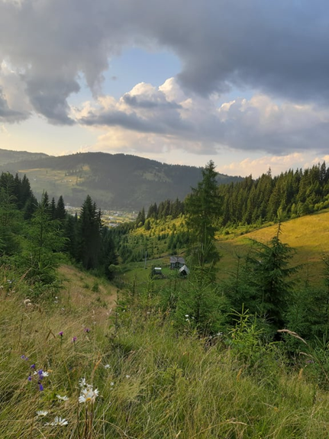
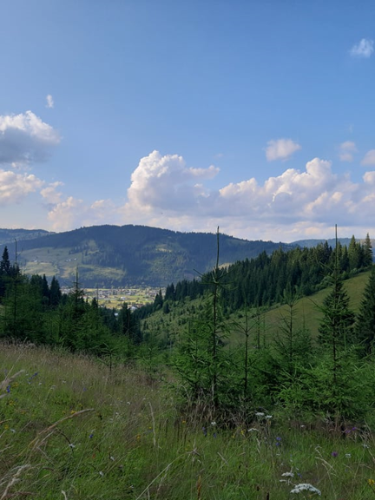
A critical analysis regarding the relationship tourism-waste management in Romania’s mountain area
In Romania the mountain area accounts for aprox. 30% of total surface (Ungureanu, Ministry of Agriculture and Rural Development – National Agency of Mountain Area), the spectacular beauty of carpathian mountain areas (see figure 2) attracting a large number of tourists which show a predilection for rural mountain areas (Ibănescu et al., 2018).
Figure 2. Mountain landscape Vatra Dornei (Photo source: Emanuela-Adina Cociș)

Slide 10
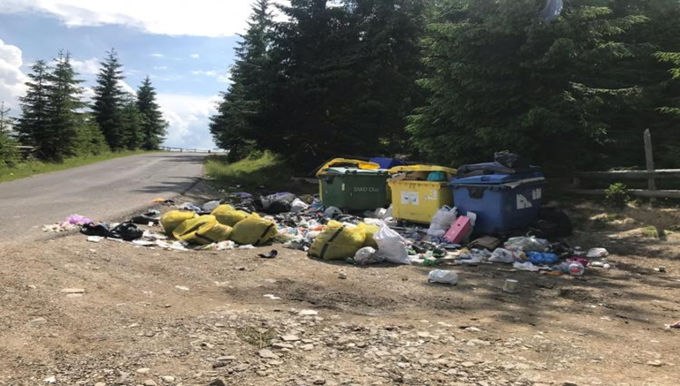
A critical analysis regarding the relationship tourism-waste management in Romania’s mountain area
The results of our analysis, showed that these touristic areas are confronting themselves with a poor waste management infrastructure (not all areas are connected to sanitation services, leading to important amounts of waste that remain uncollected) and with the absence of effective waste management programs (collection is done at large time frames, see figure 3).
Figure 3. Improper waste management in Mărișel, Cluj county. Photo source:https://www.stiridecluj.ro/economic/comuna-marisel-un-paradis-pe-pamant-nu-are-bani-nici-sa-ridice-saptamanal-gunoaiele-menajere-foto

Slide 11
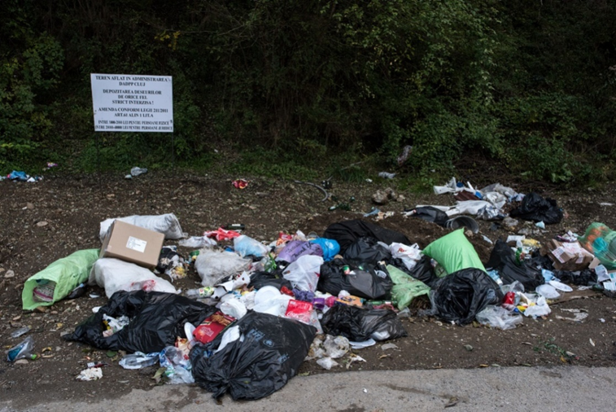
A critical analysis regarding the relationship tourism-waste management in Romania’s mountain area
These facts are leading to illegal dumping of most quantities of waste (see figure 4), disturbing the habitat and reducing the recreational value of touristic areas, similar issues being identified and reported by Murava and Korobeinykova (2016) in their study on the touristic areas from the Ukrainian Carpathians.
Figure 4. Abandoned waste on Gilău-Măguri Răcătău road. Photo source: Raul Ștef (https://pressone.ro/gunoaiele-de-pe-acoperisul-romaniei)

Slide 12
A critical analysis regarding the relationship tourism-waste management in Romania’s mountain area
Waste are becoming an integrating part of mountain landscape, one could see waste even in hardly accesible areas, sometimes in protected ones, contamination estimated to be permanent if measures are not taken immediately. There were identified various mixtures of waste such as: packages, paperboards, paper, glass, rubber, textiles, food leftovers, metal recipients, detergents, used oils, etc;
The biggest problem is represented by plastic waste and their microstructures in particular, which have a simple composition, but are extremely persistent in the environment, generating pollution for hundreds or even thousands of years (see figure 5);
It has also been found that the riverbeds and their banks are extremely vulnerable to storage and accumulation (see figure 6), a common unsustainable practice that results in the contamination of drinking water sources in some cases (see figure 7).

Slide 13
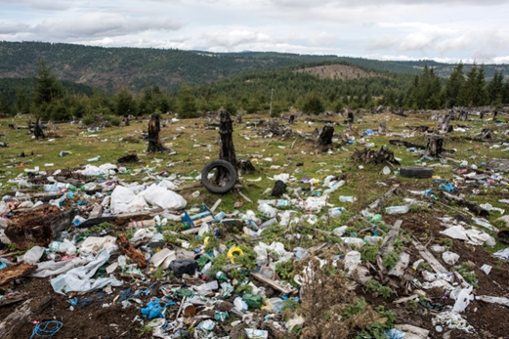
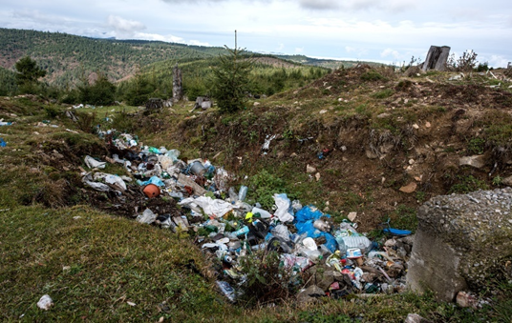
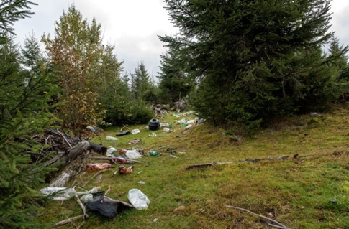
A critical analysis regarding the relationship tourism-waste management in Romania’s mountain area
Figure 5. Plastic waste in Măguri village, Gilău Mountains (1300 m altitude). Photo source: Raul Ștef
(https://pressone.ro/gunoaiele-de-pe-acoperisul-romaniei)

Slide 14
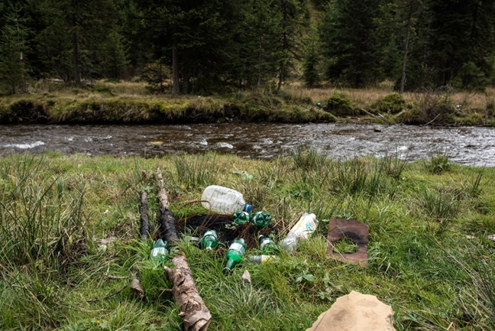
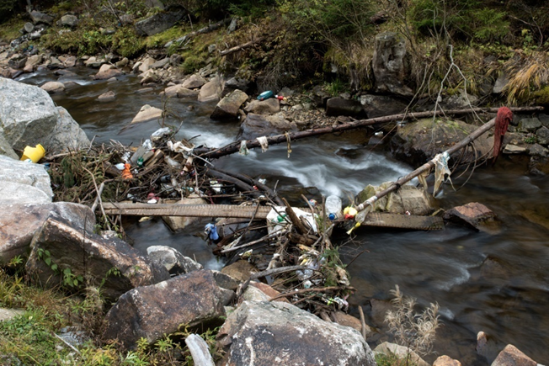
A critical analysis regarding the relationship tourism-waste management in Romania’s mountain area
Figure 6. Plastic pollution, Gilău Mountains. Photo source: Raul Ștef
(https://pressone.ro/gunoaiele-de-pe-acoperisul-romaniei)

Slide 15
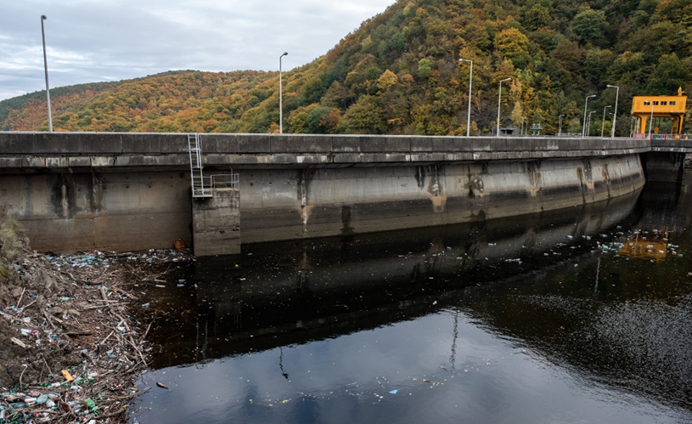
A critical analysis regarding the relationship tourism-waste management in Romania’s mountain area
Figure 7. Tarnița dam, Cluj county. Photo source: Raul Ștef
(https://pressone.ro/gunoaiele-de-pe-acoperisul-romaniei)

Slide 16
A critical analysis regarding the relationship tourism-waste management in Romania’s mountain area
Another identified harmful practice for the environment is the open burning of waste, which leads to the release into the atmosphere of smoke and various chemical compounds, of material particles and other gaseous complexes with health risks;
The most negative aspect is the presence of territorial disfunctions, respectively the placement of a waste disposal facility in a touristic mountain area, intensively transitated, without taking into account a rigorous spatial planning, without carrying out a multi-criteria analysis, namely, the controversial landfill from Mestecăniș Pass;
The area was compromised when the local authorities decided to place here, in 2007, an ecological landfill, respectively SMID (Integrated Waste Management System) from Suceava county. The project was completed, but the system is still not functional today, in 2020;
The result of a series of bad decisions is an excavated, deforested, degraded mountain, disturbed habitats, compromised wildlife, facts that flaw the tourism potential of area (see figure 8).

Slide 17
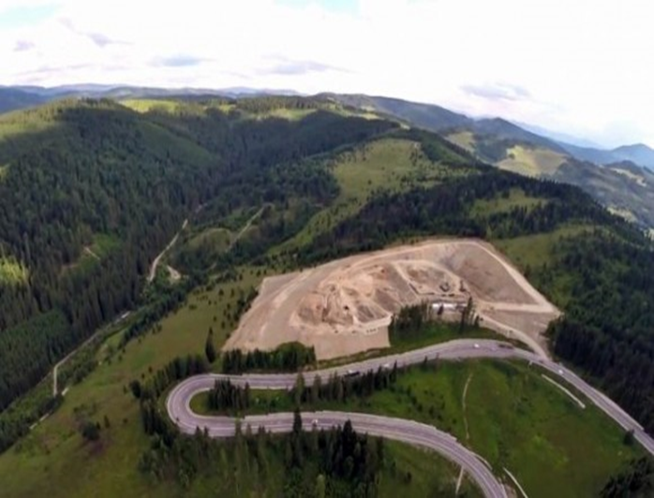
A critical analysis regarding the relationship tourism-waste management in Romania’s mountain area
Figure 8. Landfill in Mestecăniș Pass. Photo source: https://adevarul.ro/locale/suceava/groapa-gunoi-depe-mestecanis-fost-construita-ilegal-consiliul-judetean-suceava-risca-sainapoieze-uniunii-europene-banii-investiti-1_56af36da5ab6550cb856e4f3/index.html

Slide 18
Discussions and conclusions
Analyzing the relationship between tourism and waste management from Romania’s mountain areas it was found that there is a connection between the two, each exerting influence on the other;
Tourism and tourists implicitly, are generating large amounts of waste which are inappropriately managed, fact that leads to environmental degradation, recreational value and touristic potential reduction of certain mountain areas;
It was observed that the attitudes and actions of the communities members, citizens and decision makers related to waste management, bring most of the time disservices to tourism activity;
It is mandatory to proceed to a new ecological paradigm, in order to reach the "zero waste" goal, where almost everything is reused (circular economy), these steps being necessary to comply with the desiderata required by the The European Green Deal regarding the conservation of natural capital and human health;
The correction of the problems identified in the territory, as a result of the analysis carried out, can be done by acting in two ways, which are part of a sustainable waste management, namely:
planning and implementing effective and rigorous programs for waste management, investments in the waste collection infrastructure (separate collection mandatory) and transport;
increasing the degree of education and awareness of all parties involved on the other.

Slide 19
Discussions and conclusions
!!! Adopting simple prevention measures and good practice models, successfully implemented in touristic mountain areas from Europe and beyond, respectively:
-policies such as "Bring back all the garbage!;
-the placement on the mountain trails and in the camping areas of institutionalized collection points and panels which advise to proper waste management;
-organizing of seasonal cleaning and collection
!!! will lead to an improvement of the situation, to the maintenance of a clean, healthy environment, necessary for the practice of tourism in optimal conditions, thus eradicating the negative aspects associated with a poor waste management.

Slide 20
Acknowledgements
This article was funded by the project „Researches regarding the improving of the productive efficiency of bovine, ovine, caprine, pig and poultry species, by reducing the total annual emissions of greenhouse gases, expressed in tonnes of CO2-equivalents” ADER 2019-2028, code 9.1.4.

Slide 21
References
Abdou, Doaa Mohamed Salman, Nasser, H., 2018. Tourism and Environmental Degradation in the Russian Federation. International Journal of Agricultural and Environmental Sciences. Vol. 3, No. 5, pp. 64-70.
Agyeiwaah, E., McKercher, B., Suntikul, W., 2017. Identifying core indicators of sustainable tourism: A path forward?. Tourism Management Perspectives 24,26–33, doi.org/10.1016/j.tmp.2017.07.005.
Alonso-Almeida, M.M., 2013. Environmental management in tourism: students’ perceptions and managerial practice in restaurants from a gender perspective. Journal of Cleaner Production, doi.org/10.1016/j.jclepro.2012.11.034.
Apollo, M., 2016. Mountaineer's waste: past, present and future. Annals of Valahia University of Targoviste. Geographical Series, 16(2): 13-32, doi: 10.1515/avutgs-2016-0002 ISSN (Print): 2393-1485, ISSN (Online): 2393-1493.
Bel, G., Fageda, X., 2010. Empirical analysis of solid management waste costs: Some evidence from Galicia, Spain. Resources, conservation and recycling 54(3), 187-193.
Chaabane, W., Nassour, A., Bartnik, S., Bünemann, A., and Nelles, M., 2019. Shifting Towards Sustainable Tourism: Organizational and Financial Scenarios for Solid Waste Management in Tourism Destinations in Tunisia. Sustainability, 11, 3591, doi:10.3390/su1113359.
Cortes-Jimenez, I., & Pulina, M., 2010. Inbound tourism and long-run economic growth. Current Issues in Tourism, 13(1), 61–74.
European Commission, Communication from The Commission to the European Parliament, The European Council, The Council, The European Economic and Social Committee and The Committee of The Regions, The European Green Deal. Brussels, 11.12.2019 COM(2019) 640 final
Gidarakos, E., Havas, G., Ntzamilis, P., 2006. Municipal solid waste composition determination supporting the integrated solid waste management system in the island of Crete. Waste management, 26(6), 668-679.
Greco, G., Cenciarelli, V.G., Allegrini, M., 2018.Tourism's impacts on the costs of municipal solid waste collection: Evidence from Italy. Journal of Cleaner Production, doi: 10.1016/j.jclepro.2017.12.179.
Holden, A., 2016. Environment and tourism. Routledge.
https://adevarul.ro/locale/suceava/groapa-gunoi-depe-mestecanis-fost-construita-ilegal-consiliul-judetean-suceava-risca-sainapoieze-uniunii-europene-banii-investiti-1_56af36da5ab6550cb856e4f3/index.html. Accesat 30.03.2020.
https://pressone.ro/gunoaiele-de-pe-acoperisul-romaniei. Accesat 30.03.2020.
https://www.stiridecluj.ro/economic/comuna-marisel-un-paradis-pe-pamant-nu-are-bani-nici-sa-ridice-saptamanal-gunoaiele-menajere-foto. Accesat 30.03.2020.
Hu, H., Zhang, J., Chu, G., Yang, J., Yu, P., 2018. Factors influencing tourists’ litter management behavior in mountainous tourism areas in China. Waste Management 79, 273-286, doi.org/10.1016/j.wasman.2018.07.047.
Ibanescu, B-C., Stoleriu, O.M., Munteanu, A., and Iațu, C., 2018. The Impact of Tourism on Sustainable Development of Rural Areas: Evidence from Romania. Sustainability, 10, 3529; doi:10.3390/su10103529.
Jacobsen, R., Buysse, J., Gellynck, X., 2012. Cost comparison between private and public collection of residual household waste: Multiple case studies in the Flemish region of Belgium. Waste Management, 33, 3-11.
Joseph, E. K., Kallarackal, T.K., and Varghese, B., 2017. Community-Based Waste Management: Backwater Tourism as a Case Example. Atna, J Tour Stud, 12, 2 (2017), 85-94 ISSN 0975-3281, doi: 10.12727/ajts.18.5.
Kaseva, M. E., & Moirana, J. L., 2009. Problems of solid waste management on Mount Kilimanjaro: A challenge to tourism. Waste Management & Research, 28(8), 695–704, doi:10.1177/0734242x09337655.
Lebersorger, S., Weissenbacher, N., Mayr, E., and Aschauer, C., 2010. Waste management in mountain refuges – an integrated evaluation. Waste Management & Research 29(5) 549–557, doi: 10.1177/0734242X10377915.
Mateu-Sbert, J., Ricci-Cabello, I., Villalonga-Olives, E., & Cabeza-Irigoyen, E., 2013. The impact of tourism on municipal solid waste generation: the case of Menorca Island (Spain). Waste management, 33(12), 2589-2593.
Mendes, P., Santos, A. C., Nunes, L. M.,Teixeira, M. R., 2013. Evaluating municipal solid waste management performance in regions with strong seasonal variability. Ecological indicators, 30, 170-177.

Slide 22
References
Messerli, B. and Ives, J. D., (eds),1997.Mountains of the World: A global priority, Carnforth: Parthenon.
Michailidou, A. V., Vlachokostas, Ch., Achillas, Ch., Maleka, D., Moussiopoulos, N., Feleki, E., 2016. Green tourism supply chain management based on life cycle impact assessment. European Journal of Environmental Sciences, Vol. 6, No. 1, pp. 30–36, doi: 10.14712/23361964.2016.6.
Miller, R., Howell, G., 2019. Chapter 8 Rubbish and reputation How unsustainable waste management impacts tourism In: Walters, G. & Mair, J. (ed) . Oxford: Goodfellow Publishers, doi.org/10.23912/9781911396673-4120.
Murava, I., Korobeinykova, Y., 2016. The analysis of the waste problem in tourist destinations on the example of Carpathian Region In Ukraine. Journal of Ecological Engineering Volume 17, Issue 2, Apr. 2016, pages 43–51, doi: 10.12911/22998993/62285.
Nahman, A., Godfrey, L., 2010. Economic instruments for solid waste management in South Africa: Opportunities and constraints. Resources, Conservation and Recycling, 54(8), 521-531.
Passarini, F., Vassura, I., Monti, F., Morselli, L., & Villani, B., 2011. Indicators of waste management efficiency related to different territorial conditions. Waste management 31(4), 785-792.
Raza, S.A., Sharif, A., Wong, W.K & Mohd Zaini Abd Karim, 2016. Tourism development and environmental degradation in the United States: evidence from wavelet-based analysis. Current Issues in Tourism, doi.org/10.1080/13683500.2016.1192587.
Semernya, L., Alfthan, B., Ramola, A., Adler, C., Peñaranda, L.F., Andresen, M., Rucevska, I., Jurek, M., Schoolmeester, T., Baker, E., Hauer, W. & Memon, M., 2016. Waste Management Outlook for Mountain Regions – Sources and Solutions. UNEP, GRID-Arendal and ISWA. Nairobi, Arendal and Vienna. www.unep.org, www.grida.no, www.iswa.org ISBN: 978-82-7701-158-5.
Shakouri, B., Khoshnevis, S., Ghorchebigi, Y. & E., 2017. Does tourism development promote CO2 emissions?. Anatolia, 28:3, 444-452, doi: 10.1080/13032917.2017.1335648.
Shamshiry, E., Nadi, B., Bin Mokhtar, M., Komoo, I., Saadiah Hashim, H., & Yahaya, N., 2011. Integrated models for solid waste management in tourism regions: Langkawi Island, Malaysia. Journal of environmental and public health.
Simões, P., Cruz, N.F., Marques, R.C., 2012. The performance of private partners in the waste sector. Journal of cleaner production, 29-30, 214-221.
Tang, C. F., & Abosedra, S., 2014. Small sample evidence on the tourism-led growth hypothesis in Lebanon. Current Issues in Tourism, 17(3), 234–246.
Tang, C. F., 2011. Is the tourism-led growth hypothesis valid for Malaysia? A view from disaggregated tourism markets. International Journal of Tourism Research, 13(1), 97–101.
Ungureanu, D. Dezvoltarea durabilă a zonei montane din România.Realități și perspective. Ministerul Agriculturii și Dezvoltării Rurale – Agenția Zonei Montane
Winia, N., Gede Ginaya, Gede Mudana, Putu Krisna Arta Widana, 2019. Best Practice of Green Rural Tourism: Lesson from Sangkan Gunung, Karangasem. International Journal of Green Tourism Research and Applications Vol. 1, No. 1, December 2019.
World Tourism Organization., 2013. Tourism satellite account (TSA): The conceptual framework. Madrid: United Nations (UN).

