Slide 1
,,Particularities of tourism hotel services in the Republic of Moldova”
Antoci Natalia,

Slide 2
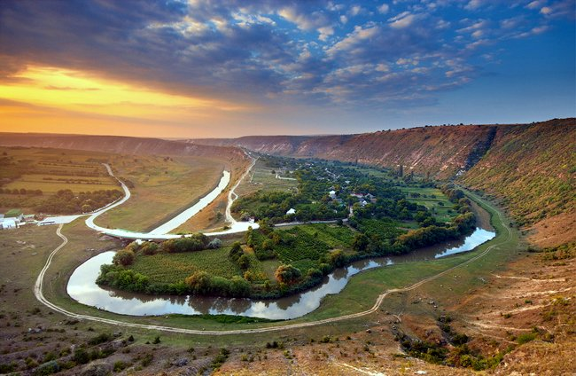

The Republic of Moldova, as a tourist destination, has a rich potential for its visitators.
The favorable physical and
Geographical location, the
excellent wines and the relatively low prices, make our country a potential tourist destination for foreign tourists.
Gf

Slide 3

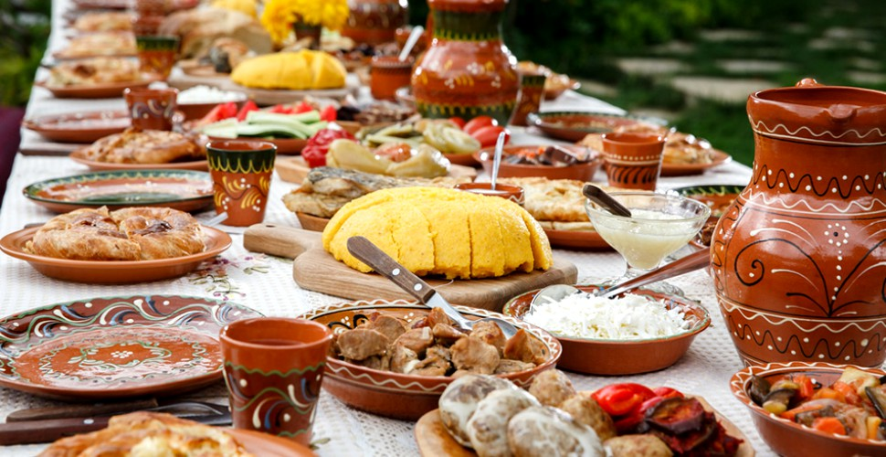

Slide 4

For Moldova, tourism is the economic sector that has a valuable potential for development, which is not yet sufficiently exploited and which can become a source of attraction for both investors and foreign tourists.

Slide 5

Foreign tourists who visit the Republic of Moldova annually can benefit from the services of 264 tourist reception structures with accommodation and dining functions, with an accommodation fund of 28067 places. This fund is enough to serve the existing flow of tourists, because, although the number of tourists who visit our country every year is increasing, this number is still very modest.
Number of collective tourist reception structures with accommodation and dining functions
 | 2014 | 2015 | 2016 | 2017 | 2018 | 2019
Total | 229 | 249 | 250 | 247 | 257 | 264
Hotels and motels | 62 | 72 | 75 | 85 | 87 | 94
Tourist pensions and agro-pensions | 11 | 15 | 13 | 15 | 19 | 19
Houses for visitors | 6 | 6 | 7 | 6 | 6 | 6
Spas and treatment resorts | 6 | 6 | 6 | 7 | 7 | 7
Holiday villages and other leisure facilities | 62 | 71 | 71 | 63 | 62 | 63
Holidays camps for children | 82 | 79 | 77 | 71 | 76 | 75

Slide 6
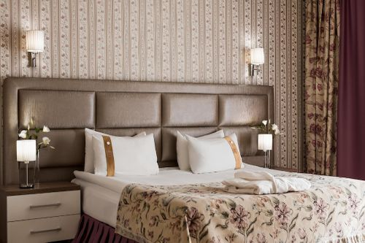
In the last decade, there has been an increase in the number of accommodation units, both in and outside of Chișinău, their number increasing by about 40% and the number go hotels and motels practically doubling, from 53 units in 2010 to 94 in 2019.

Slide 7

In the Republic of Moldova, hotels with individual exploitation predominate, activating independently, elaborating and applying their own management policies and marketing strategies. In recent years, a number of small hotels have emerged, built in the style of urban villas, which largely meet the classification requirements and which promote competitive offers on the hotel market.

Slide 8


The hotel industry often faces discrepancies in the quality of services due to inadequate classification systems, given the lack of international standards in the area. One of the most widespread classification system in the word is the European system- star rating system, which is also used in the Republic of Moldova

Slide 9
Conclusion:
In the Republic of Moldova, a business in the hotel sector, especially in rural areas, can be successful based on the following consideration: rural tourist areas are increasingly requested by citizens and foreign tourists; trips within a radius of 30-50 km from cities become competitive compared to long-distance travel abroad; the cost of services provided in agro-pensions are lower than in other accommodation units; the business can be started relatively simply and cheaply; the offer of agro-pensions is usually complex and located “under the same roof” which makes it very attractive for beneficiaries.

Slide 10


The hotel industry, the quality of accommodation service, influences not only the level of tourism development in general, but also the efficiency of this sector. The attraction excised by the accommodation services ensure a good capitalization of the capacity of the technical- material base, of the availabilities related to the labor force, all these determining the achievement of high capitalization coefficients.

