Slide 1
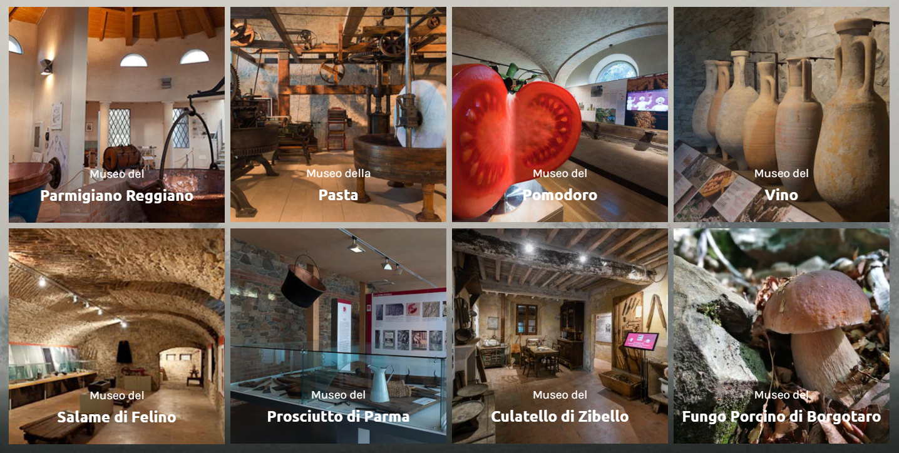
THE FOOD MUSEUMS OF PARMA,
LANDMARKS OF LOCAL GASTRONOMIC TOURISM
Laetitia CASANGIU
The Bucharest University of Economic Studies, Romania
laetitia.casangiu@gmail.com

Slide 2
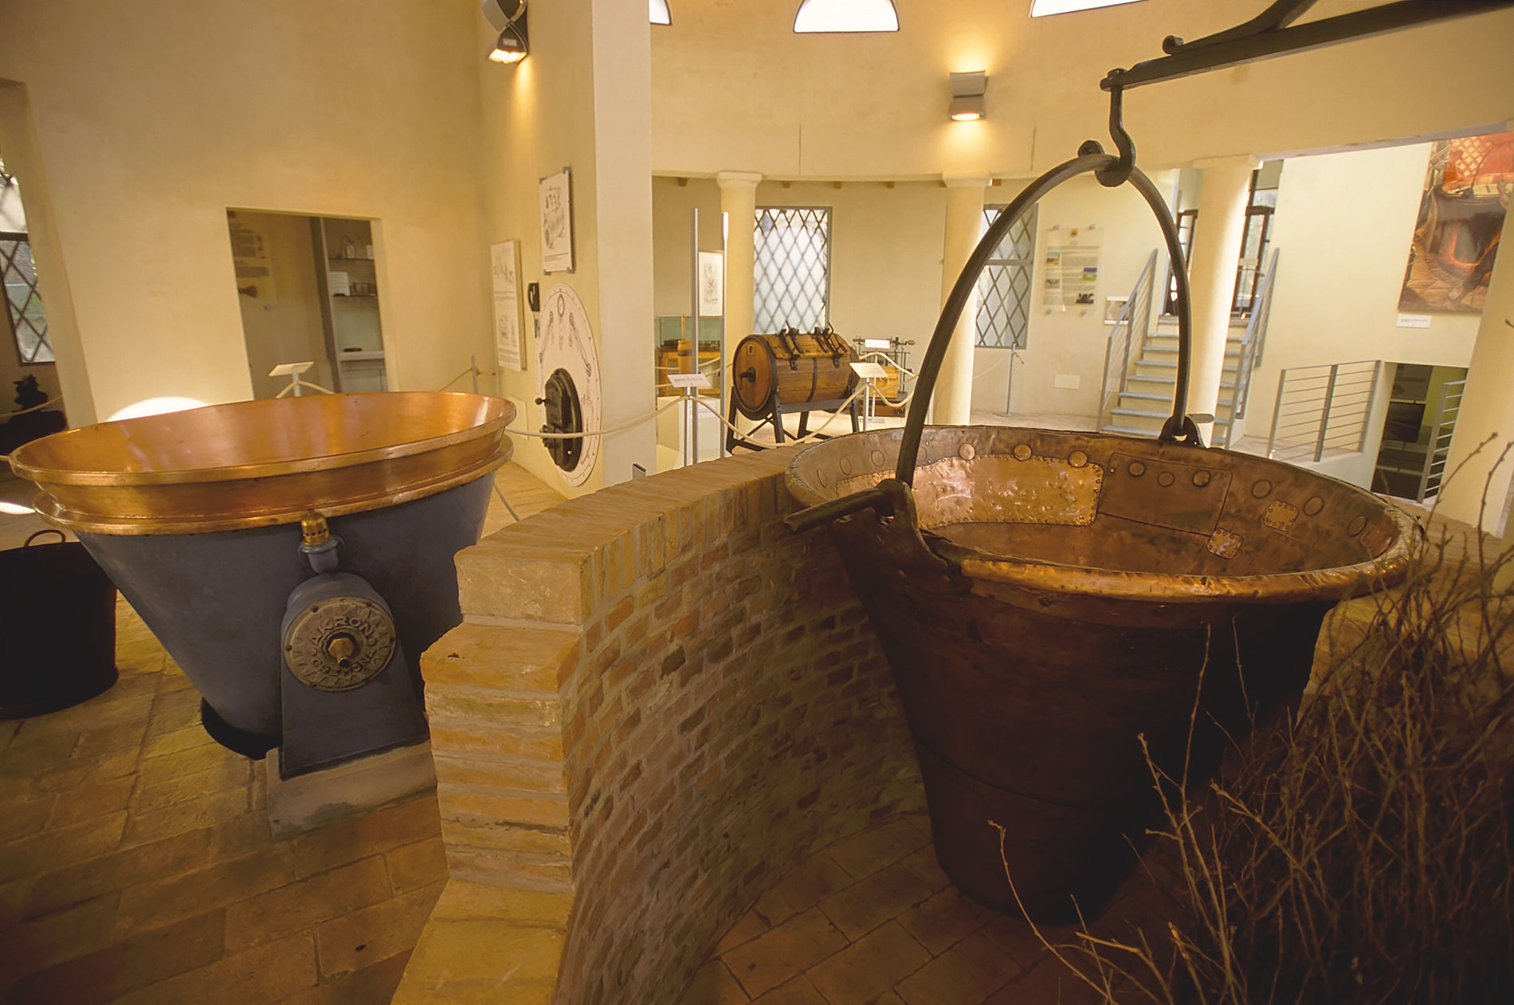
• The role played by gastronomy in tourism has been affirmed for
some centuries, since the memoirs of early travellers first started
to contain references to the culinary specialities of the places
they visited. Nevertheless, gastronomic tourism has only been
established as an independent branch of the tourism industry in
the last years, constituting an interesting subject of studies for
specialists.
• In this study we aim to present an example of good practice from
the Province of Parma, Italy, by bringing to the public’s attention
the museums dedicated to the best-known local food products,
and by highlighting their importance in promoting the local
culture, history, scenery and territorial diversity: the Parmigiano
Reggiano Cheese Museum, the Parma Ham Museum, the
Culatello di Zibello Ham Museum, the Felino Salami Museum, the
Borgotaro Mushroom Museum, the Pasta Museum, the Wine
Museum and the Tomato Museum.

Slide 3
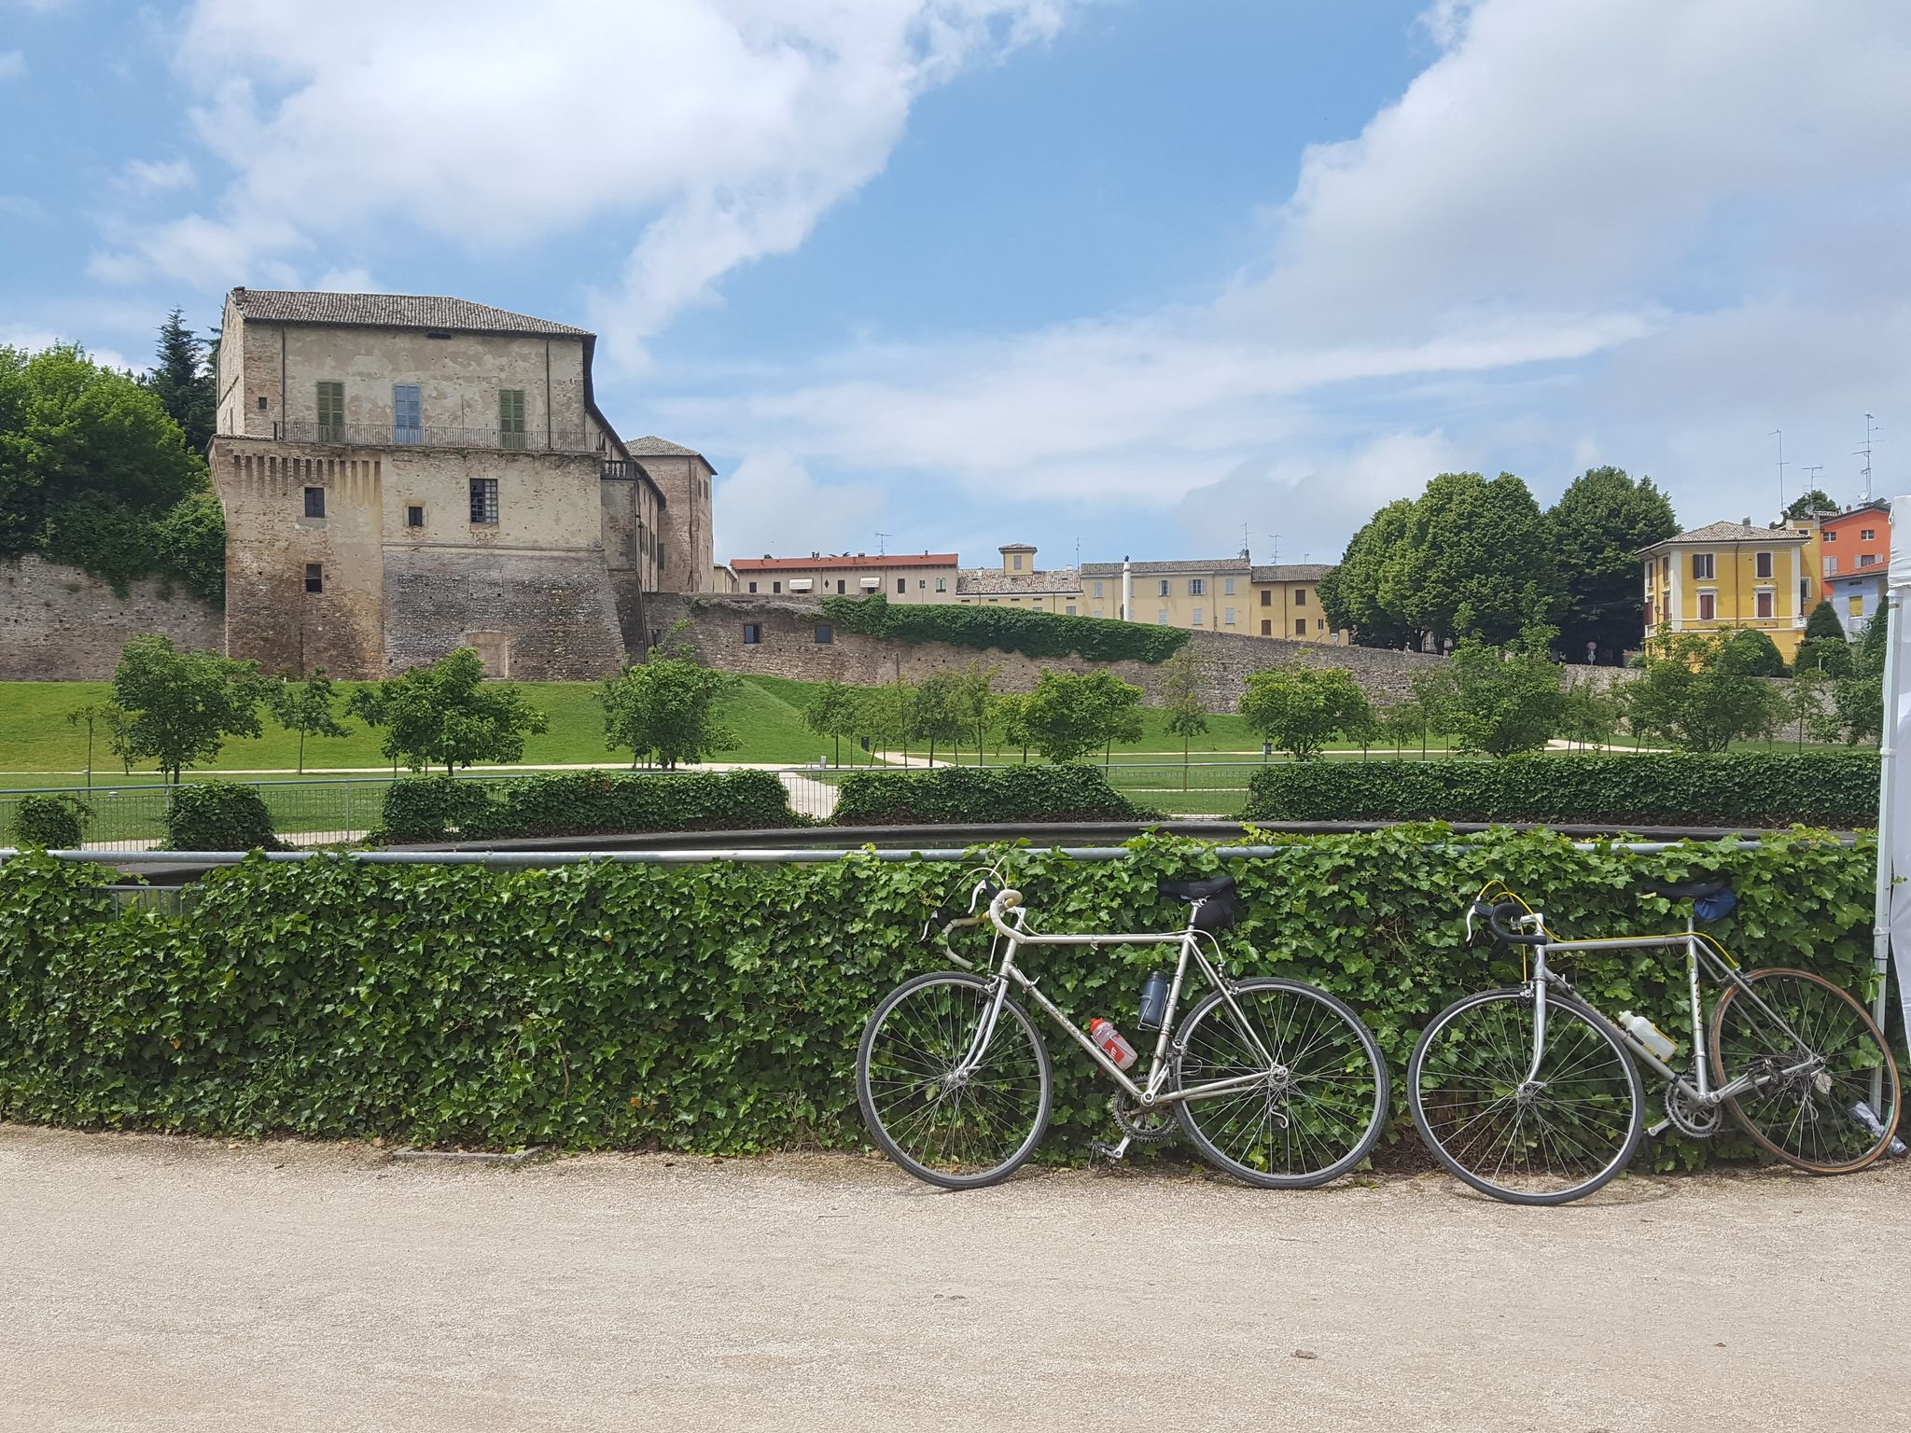
Terminological framework
Gastronomy
Culinary tourism – food tourism – gastronomic tourism
“the concept of gastronomic tourism can be applied to visitors and tourists who plan a journey with the complete or partial objective of tasting local products or partaking in activities related to gastronomy” (Gheorghe, Tudorache, Nistoreanu, 2014)
“getting to know a territory by exploring not only monuments and works of art, butalso the landscape, agricultural and food resources, is characteristic for our times.”(Montanari, 2014)

Slide 4
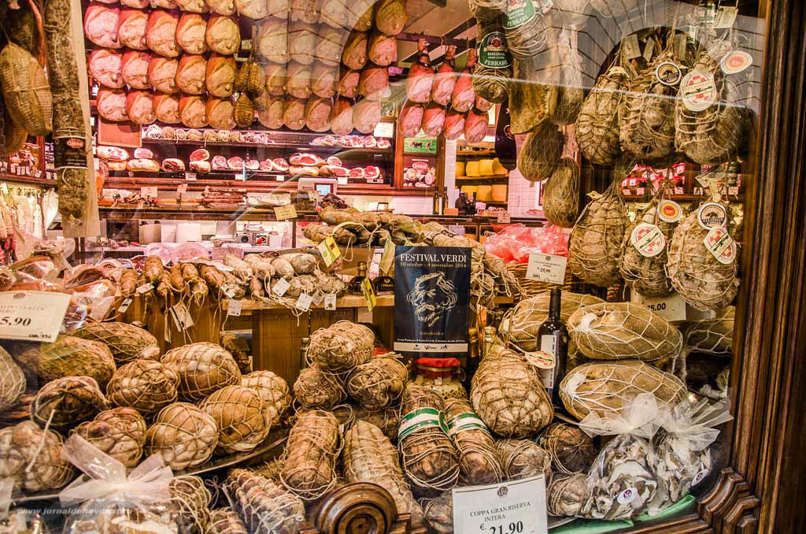
Food Museums from the Province of Parma, Italy
UNESCO Creative City of Gastronomy since 2015
Food Museums were designed as new tourism tools, aimed at completing the existent offer and at assisting in the promotion of an outstanding agricultural and food system, based upon a supply chain which starts with crop cultivation and ends on the consumer’s table.
(www.museidelcibo.it)
These museums ought to be appealing and engaging, “not only to exhibit stories, but also to tell a story, to involve all the senses (and not only the sight), to allow the tasting and purchase of the product and of other related merchandising” (Gonizzi, 2011).

Slide 5
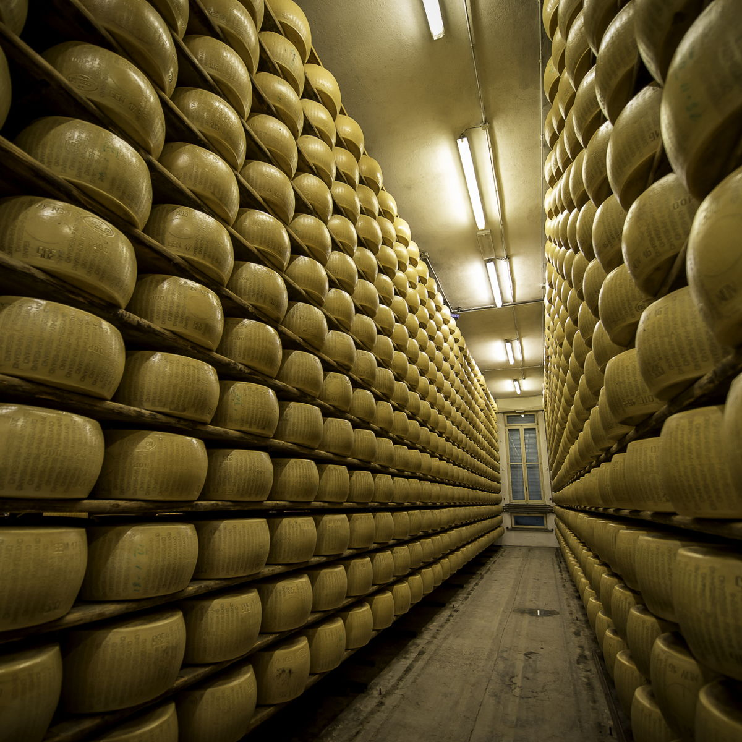
Museo del Parmigiano Reggiano
Parmigiano Reggiano Museum
(Soragna, 2003- the museum dedicated to the most renowned Italian
Cheese https://parmigianoreggiano.museidelcibo.it/)
The exhibited material was employed in the time frame between the beginning of the 19th century and the beginning of the 20th century and it comes from all of the five provinces where Parmigiano Reggiano can be produced: Parma, Reggio Emilia,
Modena, Bologna (the part of the province west of the Reno river) and Mantova (the part of the province south of the Po River).
The exhibition reveals all of the secrets of the preparation of the so-called “King of Cheese”, starting from the presentation the the local cattle breeds that produce the milk and of the techniques employed in production phases such as milking, transporting and weighing, and ending with the actual processing stages: placing the
cheese in moulds, preserving it in brine and monitoring its maturation periodically.
A section of the exhibition displays images used in the past for advertising and promoting the carachteristics of the product.

Slide 6
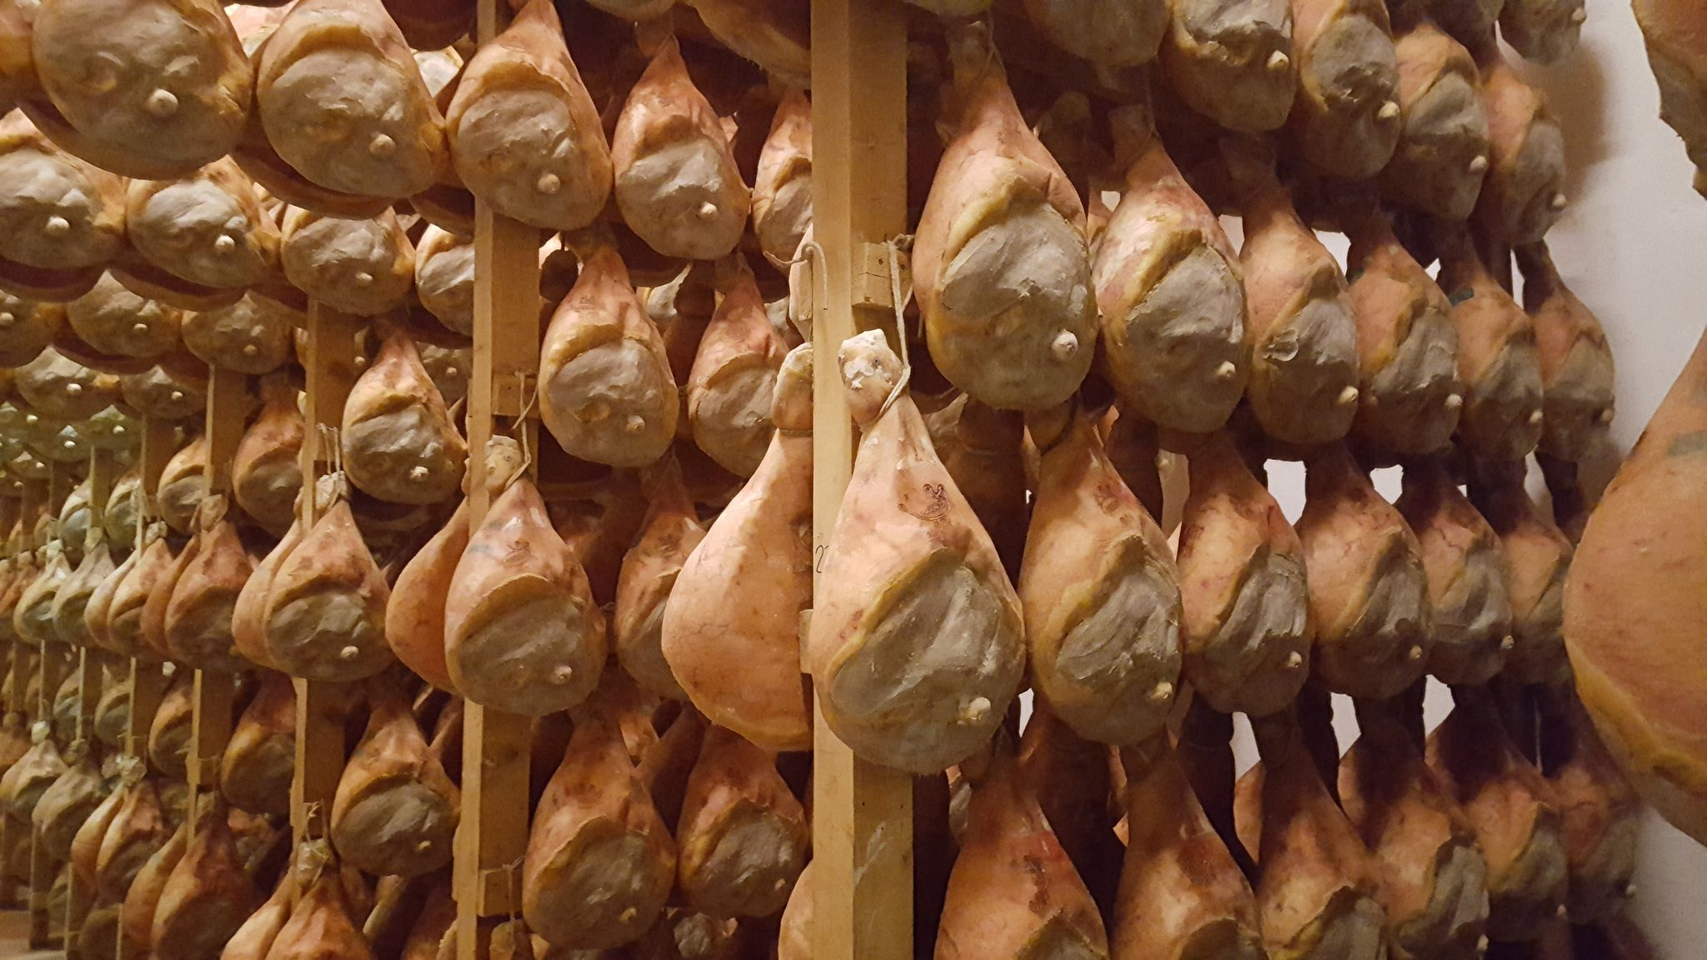
Museo del Prosciutto di Parma
Parma Ham Museum
Langhirano, 2004 - the museum dedicated to the famous raw, salted and aged ham ( https://prosciuttodiparma.museidelcibo.it/) is located in an area where the largest number of economic activities related to the cured meat industry is concentrated.
In its eight sections, the museum showcases the agriculture of the territory and the breeds of pigs used to obtain the products that have made Parma renowned throughout the world for its meat industry. Salt, a very important element in preserving meat, enjoys special attention. In addition to salt samples from around the world, the special salt of Salsomaggiore, a town near the Province of Parma mainly known for its thermal baths, is presented.
A hall is dedicated to the activity of butchery, as historically a very important figure was that of the butcher, il norcino, who employed various specific tools for slaughtering pigs and processing meat. In the following rooms other local cured meat products are presented, together with information on their use in the kitchen, through a selection of recipes dating from antiquity to the present day.

Slide 7
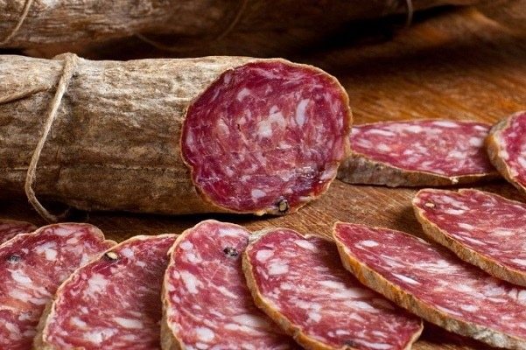
Museo del Salame di Felino
Felino Salami Museum
(Felino, 2004), the museum dedicated to the most refined salami in the region of Parma (https://salamedifelino.museidelcibo.it/)
The first section of the museum is dedicated to the historical evolution of this product, strongly bound to the territory from which the raw material, the climatic conditions and the mastery of the meat processing originate.
In another section, set up in one of the kitchens of the castle, the slaughter of the pigs is described, and the utensils traditionally used by the norcino and by peasants are exposed. In the other rooms the stages of the meat processing are described, additionally illustrated by the presence of a machine employed for filling intestines with spiced minced meat.

Slide 8
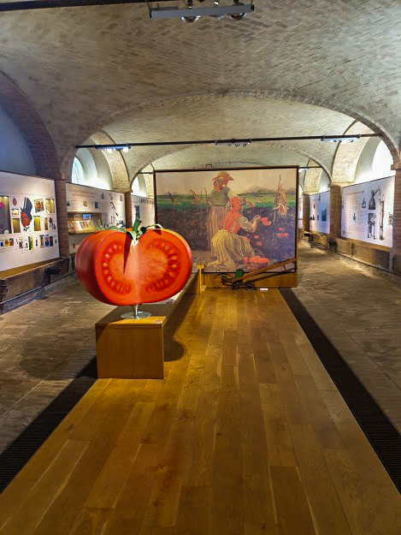
Museo del Pomodoro
The Tomato Museum
(Collecchio, 2010) (https://pomodoro.museidelcibo.it)
In the halls of the museum the history of an important industry that has contributed to the reputation and welfare of an entire region is covered, with the help of images, archive documents, tools and equipment.
After a presentation of the origin and evolution of the plant, the second section of the museum is dedicated to the canning industry. The itinerary continues with an area dedicated to the first industrial machines and processing equipment, belonging to the very first factories set up in Parma.
In the section dedicated to the products obtained from the processing of different varieties of tomatoes, there is an original collection of metal broth containers dating from 1938. An interesting element of the exhibition is the advertising material, made of posters from the early twentieth century, true artistic masterpieces created by wellknown illustrators and painters.

Slide 9
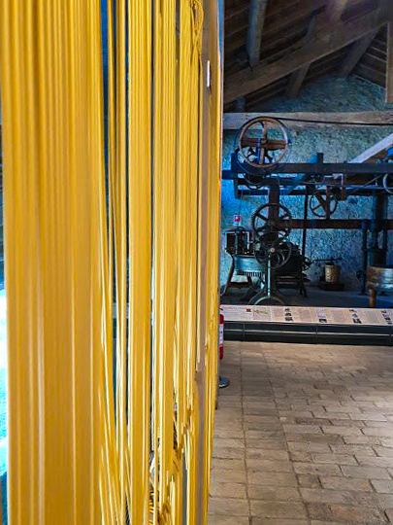
Museo della Pasta
The Pasta Museum
(Collecchio, 2014) ( https://pasta.museidelcibo.it)
The exhibition route of the museum includes a series of showcases which exhibit tools of different sizes, and large panels which illustrate different types of wheat, the evolution of processing techniques and over three hundred types and shapes of pasta. A section is dedicated to the grinding process, and millstones, miniature mill models and restored authentic exhibits such as a rolling mill are exhibited.
The area dedicated to pasta contains the first kitchen utensils employed for its preparation. Passing to the area dedicated to industrial production, a machine dating from the mid-19th century is exposed, together with a prototype of a fully automated machine from 1942. In the museum we also find an impressive collection of perforated metal discs, with holes of different shapes and sizes, used to obtain the different types of pasta, and a collection of sieves and strainers.
The section dedicated to advertising and communication is also extremely interesting, as it showcases lithographs and posters, a part of the historical culture of the entire country.

Slide 10
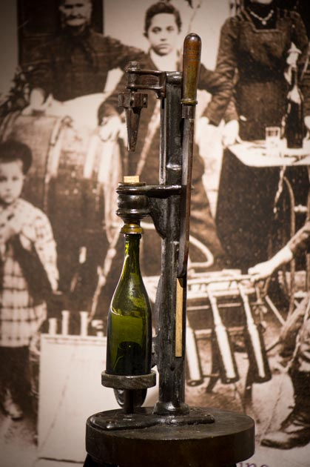
Museo del Vino
The Wine Museum
Sala Baganza, 2014 (https://vino.museidelcibo.it)
In the first room objects and images collected from archaeological excavations are exhibited, bearing witness to the habit of local ancient populations of drinking concentrated wine, as was the Celtic custom, differently from the Greek or Roman custom of flavouring wine or diluting it with water.
In the following rooms tools and techniques related to viticulture are presented, together with materials used for harvesting grapes and preparing wine. Next is the area where barrels are kept and where other types of containers are displayed, along with a rich collection of corkscrews.
The types of local wines and the ways in which they can be consumed are then presented, and the visit ends, as in the case of other museums, with a tasting of local wines.

Slide 11
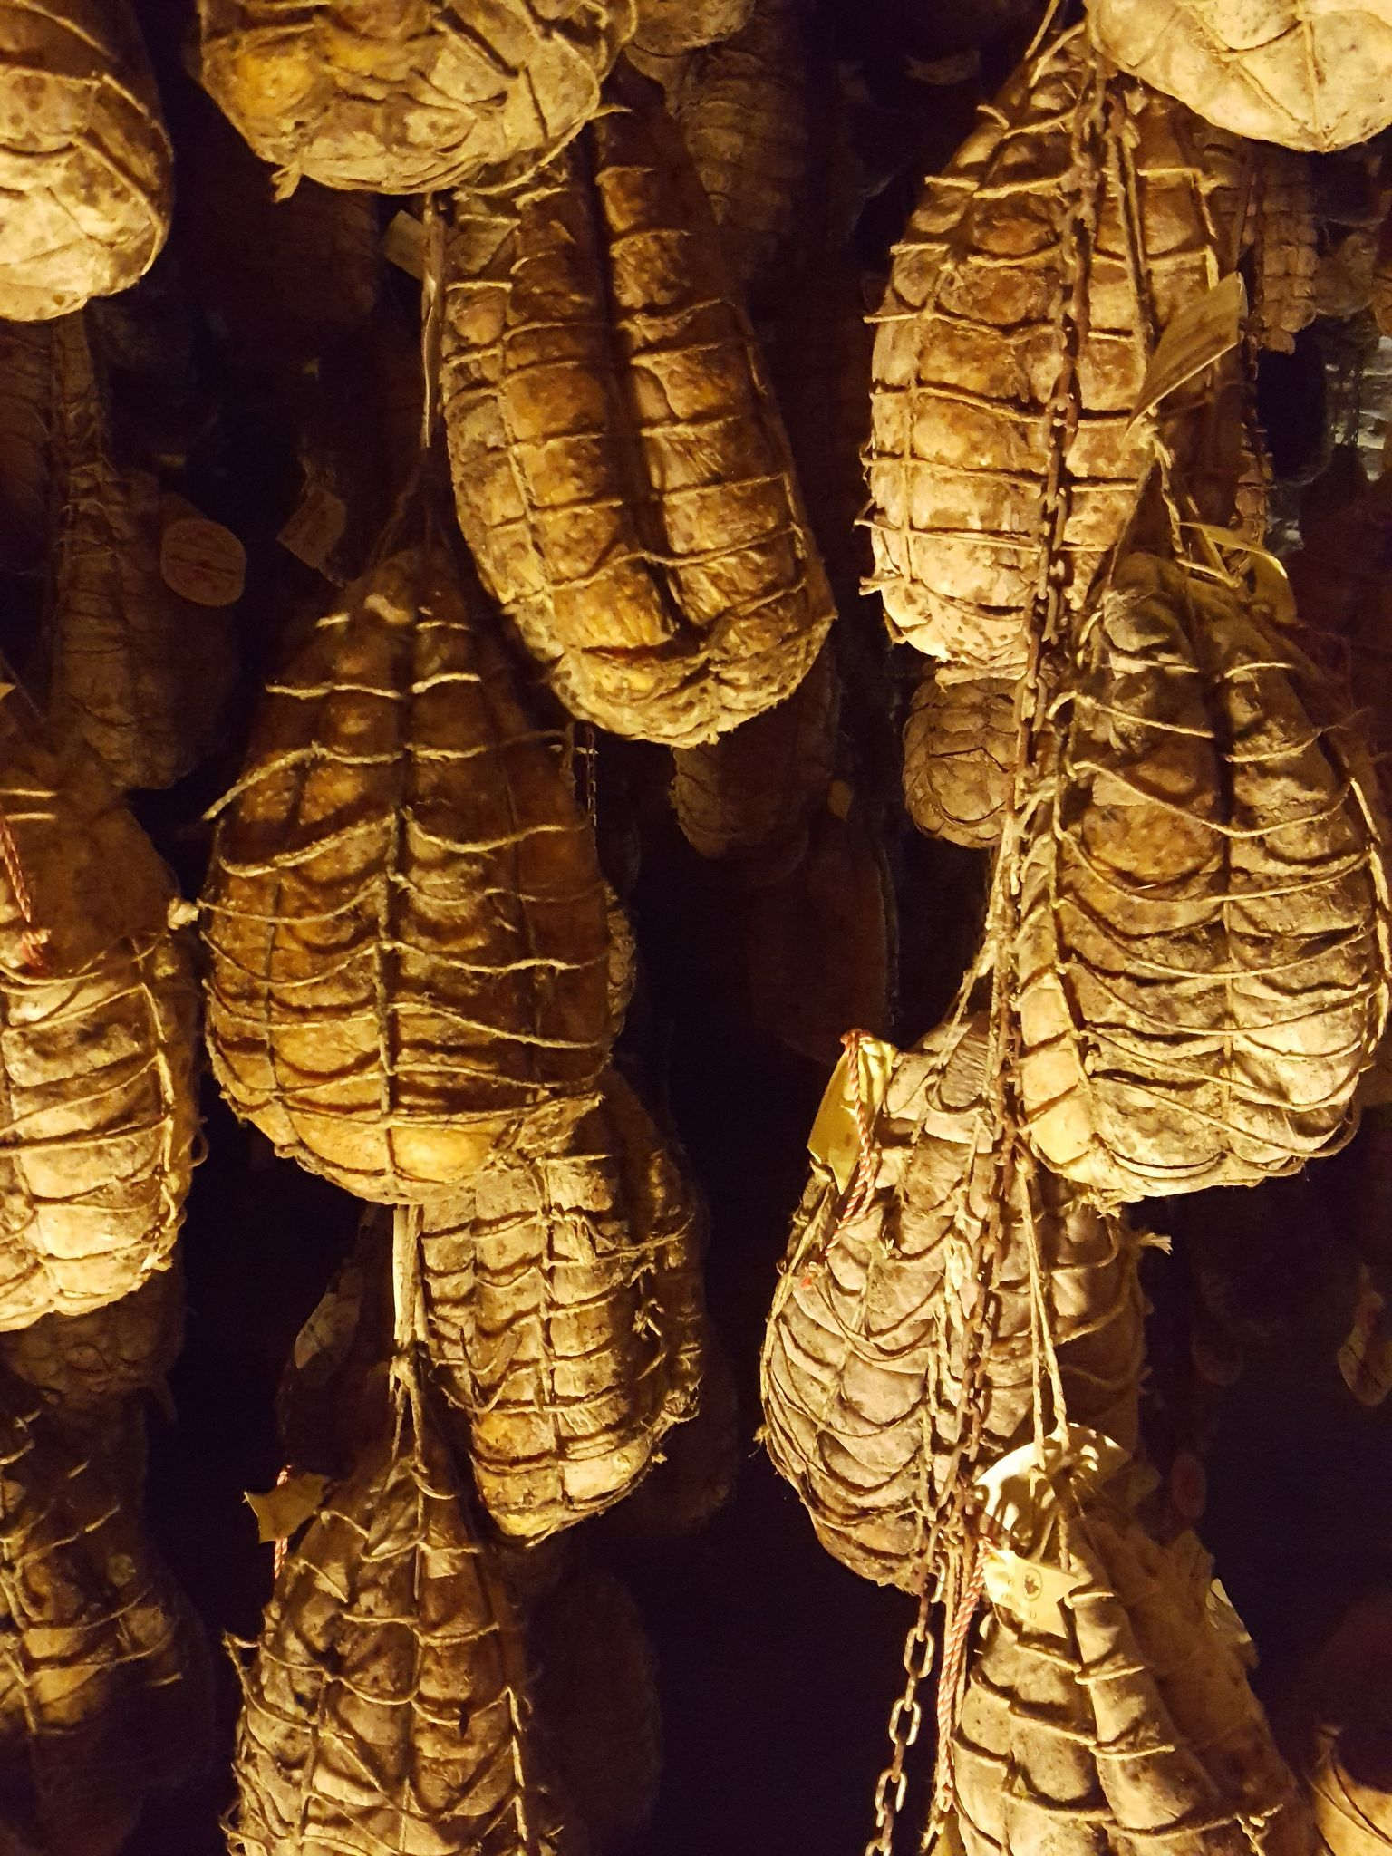
Museo del Culatello di Zibello
Culatello di Zibello Ham Museum
(Polesine, Antica Corte Pallavicina, 2015), the museum dedicated to the ham renowned as “The King of Cured Meats” (https://culatellodizibello.museidelcibo.it)
In the halls of the museum we discover objects and illustrations that present the breeds of pigs used for making the ham, the meat processing techniques and a lot of additional information related to the specifics of the area and of the family that had the initiative to set up the museum. A really spectacular part of the exhibition is the
gallery where maturing culatelli are displayed, which is followed by a tasting of the ham.
Museo del Fungo di Borgotaro – The Museum of the Borgotaro Mushroom
The last museum of the circuit, dedicated to the Borgotaro Mushroom (IGP), is currently being set up.

Slide 12
The food museum does not solely constitute a static place where objects and accounts related to the past are gathered, but a dynamic venue where food processing techniques and their importance in the industrial system can be presented to the general public. The food museum can thus become an important link in the chain which connects the territory with the production sector and with the tourism offer.
The paper presented during the conference brings to the fore an example of good practice in Italy, by presenting a tourist product which is still little known in Romania: the food museum. This type of museum could be picked up and developed on a large scale inour country, in areas where there already is a tradition in the cultivation, processing and marketing of quality food products.
Such an initiative could contribute to the improvement of gastronomic circuits and, implicitly, to the development of rural areas, by capitalizing on local human and materialresources. Similar structures could also play an important role in carrying out teaching activities such as Școala Altfel (the initiative which gives school students the chance to experience novel learning experiences in addition to their usual classroom activities): in laboratories and workshops, students could be given information about certain traditional handicrafts and about Romanian agriculture and food products.
Conclusion

Slide 13
References
Brillat-Savarin, Jean Anthelme, Physiologie du goût, Paris, 1848
Butnaru Gina Ionela, Ungureanu Dănuț, Traditional cuisine and culinary tourism, în “Turismul Rural
românesc în context internațional. Actualitate și perspective”, Institutul de Cercetări Economice şi Sociale „Gheorghe Zane”, Iaşi, 2019
Cazelais Normand, Le tourisme gourmand: la dictature des guides?, Téoros-Revue de recherche en
tourisme, 2006
Civitello Linda, Cuisine and Culture: A History of Food and People, Hoboken, New Jersey/John Wiley &Sons, 2011
Cultura Gastronomica Italiana, Musei del gusto. Mappa della memoria enogastronomica, Carsa Editore, 2007
Everett Sally, Production Places or Consumption Spaces? The Place-making Agency of Food Tourism in Ireland and Scotland, Tourism Geographies 14(4):1-20·February 2012
Falletti Vittorio, Maggi Maurizio, I Musei, Il Mulino, 2012
Feuerbach Ludwig, L'uomo è ciò che mangia, Bollati Boringhieri, 2017
Gazzetta di Parma, Musei del Cibo, boom di visitatori, 11 december 2019, p. 15
Gheorghe Georgică, Tudorache Petronela, Nistoreanu Puiu, Gastronomic tourism, a new trend for
contemporary tourism, in Cactus Tourism Journal Vol.9, Issue 12014, Pages 12-21
Guigoni Alessandra, Antropologia del mangiare e del bere, Edizioni Altravista, 2009
Gonizzi Giancarlo, I musei del cibo della Provincia di Parma. Un progetto di valorizzazione della cultura alimentare e del territorio, in Aurea Parma- Rivista di Storia, Letteratura e Arte, september-dicember 2011
Ionescu Th. și Duployen N., Constanța și Tekirghiolul- Ghid Ilustrat, Editura Institutului Grafic Albania, Constanța, 1924
Montanari Armando, Geography of taste and local development in Abruzzo (Italy): project to establish a training and research centre for the promotion of enogastronomic culture and tourism, Journal of Heritage Tourism, 2009
Montanari Massimo, Il cibo come cultura, Laterza, 2006
Montanari Massimo, Produzione e consumo del cibo, accoglienza e ospitalità: vol. 1 Dal Medioevo al Seicento, Laterza, 2014
Montanari Massimo, Produzione e consumo del cibo, accoglienza e ospitalità: vol. 3 Dal Novecento a oggi, Laterza, 2014
Nistoreanu Bogdan Gabriel, Nicodim Liliana, Diaconescu Dan Mihnea, Gastronomic Tourism- stages and evolution, Proceeding of the 12 th International Conference Business Excellence, 2018,Sciendo, vol. 12(1), pages 711-717
Villa Mariagrazia, Il museo del Parmigiano Reggiano, in Parma Economica, n.1 – 2010
Villa Mariagrazia, Il museo del Salame di Felino, in Parma Economica, n.1 – 2010
Villa Mariagrazia, Gonizzi Giancarlo, Museo della Pasta, Grafiche Step Editrice Parma, 2015
Villa Mariagrazia, Gonizzi Giancarlo, Museo del Pomodoro, Grafiche Step Editrice Parma, 2015
Villa Mariagrazia, Gonizzi Giancarlo, Museo del Prosciutto, Grafiche Step Editrice Parma, 2015
Villa Mariagrazia, Gonizzi Giancarlo, Museo del Parmigiano Reggiano, Grafiche Step Editrice Parma, 2015
Villa Mariagrazia, Gonizzi Giancarlo, Museo del Salame, Grafiche Step Editrice Parma, 2015
Encyclopadia Britannica (2000): www.eb.com
Musei del Cibo: www.museidelcibo.it- consulted 8 avril 2020
World Food Travel Association:
https://worldfoodtravel.org/what-is-food-tourism-definition-food-tourism/- consulted 8 avril
2020

